Slide 1

How to Fix an Inherited Report
Kristyna Ferris

Slide 2


About Me ~ Kristyna Ferris
Microsoft MVP, senior data engineering consultant at 3Cloud, Lexington Data Technology Group co-organizer , co-author on DataOnWheels, co-founder of Data On Rails
My experience includes implementing and managing enterprise-level Power BI instances, training teams on reporting best practices, learning new coding languages to hack into Power BI, and building templates for scalable analytics.
Check out my blog: https://dataonwheels.wordpress.com/
Check out my blog platform: https://dataonrailsblog.wordpress.com/
Connect on LinkedIn: https://www.linkedin.com/in/kristyna-hughes-dataonwheels/
Connect on Twitter: @data_dragoness
Connect on BlueSky: @data-dragoness
GitHub

Slide 3


Slide 4
The Big Break

Slide 5

Ope

Slide 6
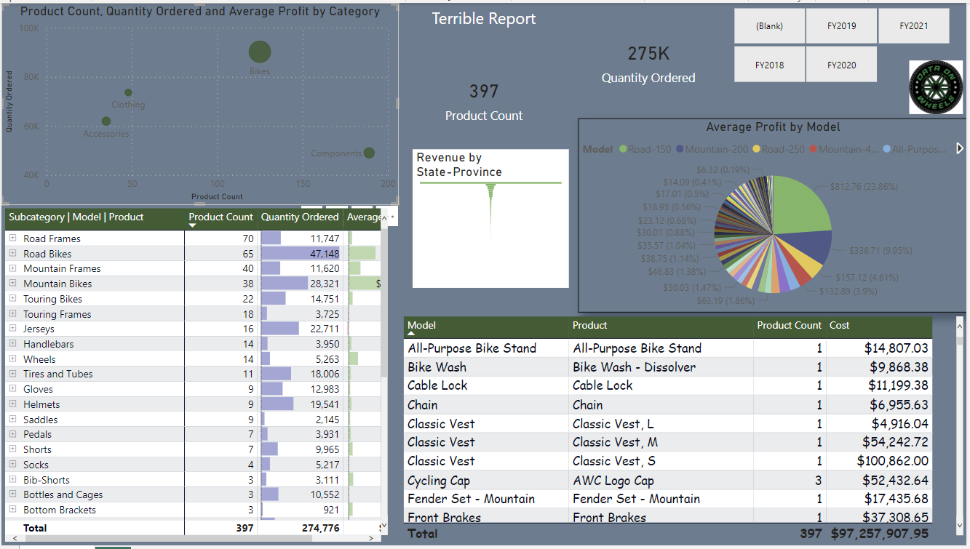

Slide 7

Next Steps
Save a copy of the report before changing anything.
Meet with stakeholders to understand what’s working, and more importantly what’s no working. Key is to build trust.
Break down the issues into manageable tasks.
Define “done” with stakeholders to avoid a development spiral.
Remember – there are things you cannot fix.

Slide 8
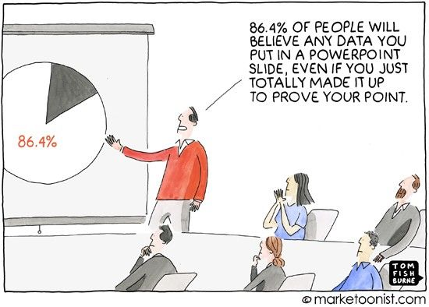
Accuracy = Trust = Adoption
Working with stakeholders builds trust, and when they trust a report, they will use it more often.
Data accuracy is paramount to building trust. Consistently check data accuracy of the existing report and make sure insights are clear and easy to understand.
Avoid pie charts, avoid confusion.

Slide 9
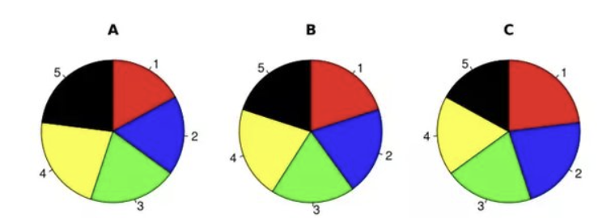
Can you rank these slices largest to smallest?
Notes:
Pies and donuts are better desserts than visuals

Slide 10
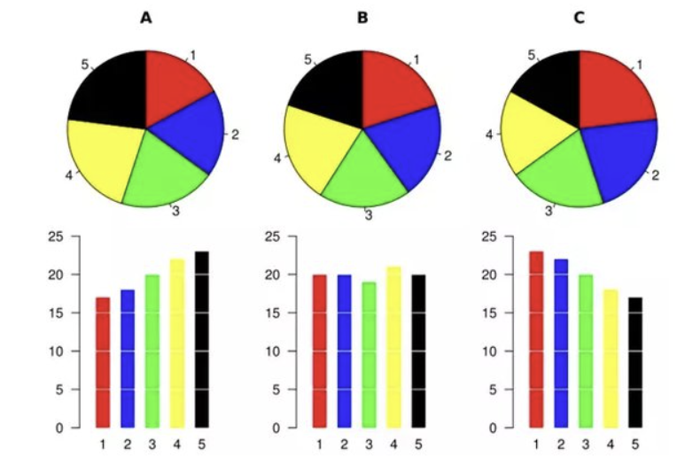
Results, how many did you get right?
A
5, 4, 3, 2, 1
B
4, 5/2/1, 3
C
1, 2, 3, 4, 5
Notes:
Pies and donuts are better desserts than visuals

Slide 11
The Design Checklist
Front End Design
About 6- 10 insights per page
Be mindful of using the correct visual
Include trending visuals
Group related metrics
Size visuals to be readable
Use consistent color palette
Add clear headings & labels
Round numbers where necessary
Run through the report from top to bottom from left to right like reading a news paper
Super useful reference: https://www.numerro.io/guides/the-complete-guide-to-designing-power-bi-reports
Back End Design
All columns and tables are used for either a visual or metric
No extra metrics
No many to many relationships (very rare cases for these)
Metrics and data have been tested and are trusted by stakeholders
Relationships flow the correct direction and are on the correct fields
Organize the modeling view
Use a calculations table or folders to house all your metrics
Know when to build from scratch

Slide 12

Demo Time!

Slide 13

Questions?

Slide 14

Don’t forget to connect, thanks for listening!
Blog: https://dataonwheels.wordpress.com/
Email: Kristyna@dataonwheels.com
Twitter: @data_dragoness
LinkedIn

